Slide 1
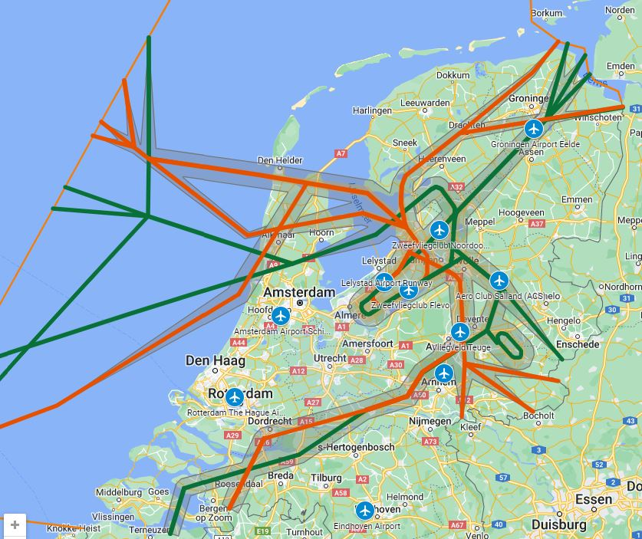
Website: https://satl-lelystad.nl/
Notes:
Website: https://satl-lelystad.nl/

